Slide 1
HAM CHEAP
Two cheap ways to do APRS
By
Jerry Aberdeen-KB3RWT
Dec. 21 2024

Slide 2
What is APRS
Automatic Packet Reporting System(APRS) is an amateur radio based system for real time digital communications of information.
APRS was first developed by Bob Bruninga WB4APR, who maintained the main APRS website until his death in 2022. The acronym "APRS" was derived from his call sign.
APRS was first developed for the US navy to track naval assets.

Slide 3
What is APRS cont’d
APRS packets are transmitted for all other stations to hear and use. Packet repeaters, called digipeaters, form the backbone of the APRS system, and use store and forward technology to retransmit packets.
All stations operate on the same radio frequency, and packets move through the network from digipeater to digipeater, propagating outward from their point of origin.

Slide 4
What is APRS cont’d
In addition, all such data are typically ingested into the APRS Internet System (APRS-IS) via an Internet-connected receiver (IGate) and distributed globally for immediate access.
Data shared via radio or Internet are collected by all users and can be combined with external map data to build a shared live view.

Slide 5
What can APRS used for?
APRS can be used to transmit data such as : GPS Locations, Non directional Beacons, Weather information, text messages, announcements etc.
APRS data can be displayed on a map(www.aprs.fi etc), which can show stations, objects, tracks of moving objects, weather stations, search and rescue data, and direction finding data.

Slide 6
Building a cheap android mobile APRS station
Items needed:
Tablet or Phone with android OS
APRSdroid for android devices: downloadable via the Google app store for $4.99 or for free from https://aprsdroid.org/downloAPRSad - this uses the android APK which involves manual installation to your smart device
APRS Droid is an Android application that can be used to encode and decode APRS packets using a smart device GPS and audio jack.
Notes:
APRS can be done either mobile or stationary

Slide 7
About APRSdroid
You can use APRSdroid to connect to the APRS network via different means:
APRS-IS via Internet (WiFi or mobile data connection)
AFSK (audio connection between your radio and the Smartphone)
Bluetooth-serial connection to a TNC

Slide 8
Procedure
Download APRSdroid from app store and install on your device
Or if downloading the APK, download the latest version which at the time of writing this document was aprsdroid-gl-2024-04-03.apk found at https://aprsdroid.org/download/builds/aprsdroid-gl-2024-04-03.apk to a computer then side load the apk to your device.

Slide 9
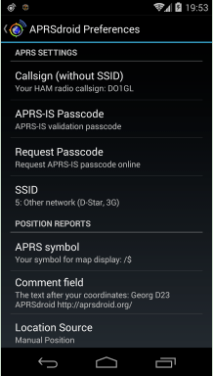
Configuring APRSdroid
Open Aprsdroid and go to Preferences
Setup the Following:
Callsign without SSID: Your Callsign

Slide 10
Configuring APRSdroid
SSID: I use -10 for APRS-IS no radio
APRS digipath: set to WIDE1-,WIDE2-1
APRS connection type/APRS preference: set to Internet(aprs-is) you will need a passcode to connect to the aprs internet network
Using your computer go to https://aprs.do3sww.de/ and obtain a passcode using your callsign.

Slide 11
Configuring APRSdroid
Under the APRS connection type/APRS preference tap APRS-IS passcode and enter your callsign and the passcode you got.
NB:The passcode is unique to your callsign.
APRS symbol: choose a symbol that represents you (such as a car or a person- I use the stickman.

Slide 12
Configuring APRSdroid
Voice frequency : The frequency you monitor for voice contacts. I use 146.52 as I monitor that frequency.
Comment Field: enter a comment you want sent with your position report.
Location settings: Tap on SmartBeaconing and enable it -this will adjust your beacon rate based on your speed and direction.
Position privacy: leave off

Slide 13
Configuring APRSdroid
Keep screen awake : tick the box
Notifications: I use default settings.
You should now have a basic APRS setup that you can use. You can configure the other settings too your likings.

Slide 14
Using APRSdroid
The next step is to go to the main page and select START TRACKING
Go to the 3 dots on the upper right side of the screen and select send position
Go back to the 3 dots on the upper right side of the screen and select show map
Depending on the size of your device screen you may have to adjust the device screen to see stations around you on the map.

Slide 15
Using APRSdroid
To track a station on the map simply click on the station name and select track.
To send a message to a station simple select the station and touch the triangle, a message box will come up an you type your message and then hit the ok button on the lower right of the screen.

Slide 16
Portable APRS via RF
Items needed:
Radio- HT or mobile
APRSdroid for android devices
Smart Device-tablet or phone
Cable to interface radio to Smart device
Notes:
APRS can be done either mobile or stationary

Slide 17
Portable APRS via RF
Install and setup aprsdroid as per the previous slides, (setup on a smart device).
Tap on connection preferences and select AFSK (via mic/speaker).
Plug one end of the cable into the speaker and microphone jacks of your radio.
Plug the other end of the cable into the audio jack of your smart device.

Slide 18
Portable APRS via RF
Turn on your radio and set it to 144.390 MHz
Turn on your Smartphone and open APRS Droid app
Tap on Start Tracking to begin sending and receiving APRS packets
To see stations around you simply select the map in APRSdroid

Slide 19
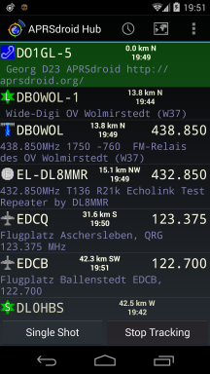
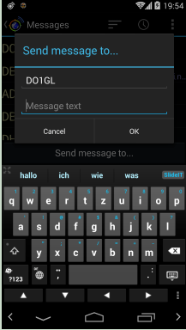
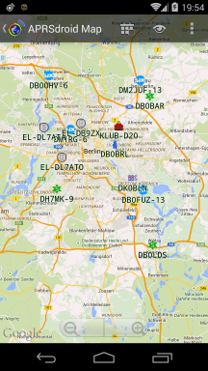
Some Screenshots of APRSdroid

Slide 20
Some APRS sites and Clients
Websites:
https://aprs.fi/
https://aprs.to
https://aprs-map.info
APRS Clients:
Pinpoint- https://pinpointaprs.com/
APRSdroid- https://aprsdroid.org/
Ui-view-https://www.ui-view.net/
Win Aprs- https://www.winaprs.com/
Xastir(Linux)- https://www.xastir.org/
YAAC - https://www.ka2ddo.org/ka2ddo/YAAC.html

Slide 21
A Build case scenario
Radio-Baofeng UV5-R
Software: APRSdroid
Smart Device: Lenovo Tablet
Cable: Cable to connect UV5-R to Lenovo Tablet

Slide 22
Sources
https://en.wikipedia.org/wiki/Automatic_Packet_Reporting_System
https://aprsdroid.org/
https://b10a.co/posts/2023/03/aprsdroid-baofeng-uv5r/
https://adventuretaco.com/tag/aprsdroid/

